Slide 1
Dong et al. [2008] generated solid textures on GPU by limiting the synthesis domain to a subset of the voxels around the object surface
In fact, a training texture is considered as an exemplar and the synthetic texture as a rearrangement of image signals randomly and coherently sampled from the training one.

Slide 2
High Quality Solid Texture Synthesis using Position and Index Histogram Matching Chen, J. and Wang, B. 2010. High quality solid texture synthesis using position and index histogram matching. Vis. Comput. 26, 4 (Apr. 2010), 253-262.
Jiating Chen^{1,2}, Bin Wang¹
¹School of Software, Tsinghua University
²Department of Computer Science and Technology, Tsinghua University

Slide 3
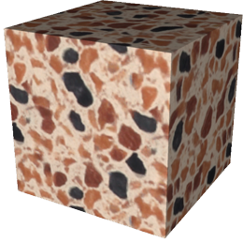
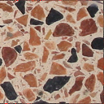
Introduction
Texturing is a core process for modeling surface details in computer graphics applications
Texture mapping
Surface texture synthesis
Procedural texturing
Solid texture synthesis
？
color = f(x, y, z)
Exemplar
Solid texture

Slide 4
Previous Work
Wei [2002] adapted 2D neighborhood matching synthesis schemes to 3D volumes
Jagnow et al. [2004] proposed a solid texture synthesis method based on stereology techniques
Kopf et al. [2007] extended 2D texture optimization technique to synthesize solid textures.
Dong et al. [2008] generated solid textures on GPU by limiting the synthesis domain to a subset of the voxels around the object surface

Slide 5
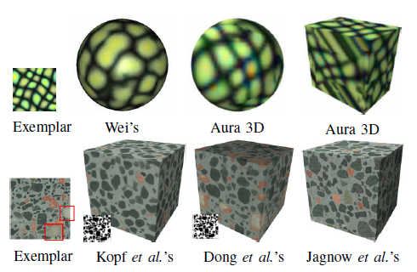
Synthesis Quality Problems for the Previous Methods
Color blurry
Introducing aberrant voxel colors
Bad texture structures
Some distinct texture structures are even missing!

Slide 6
Overview
Aims at generating high quality solid textures from 2D exemplars
Adopt the texture optimization framework [Kwatra et al. 2005] with the k-coherence search [Tong et al. 2002] and the discrete solver [Han et al. 2006]
The optimization approach is integrated with the position and index histogram matching
Preserves not only color histogram but also the texture structures, reaching high quality results

Slide 7
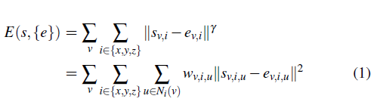
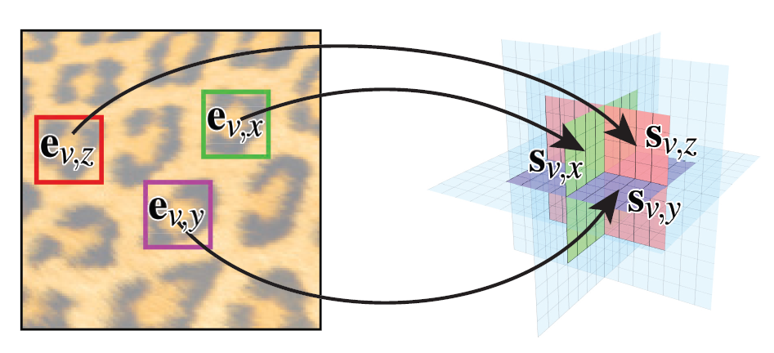
Solid Texture Energy Function
Similar to Kopf et al. [2007], the goal is to minimize a global texture energy function, defined as:
From Kopf et al. [2007]

Slide 8
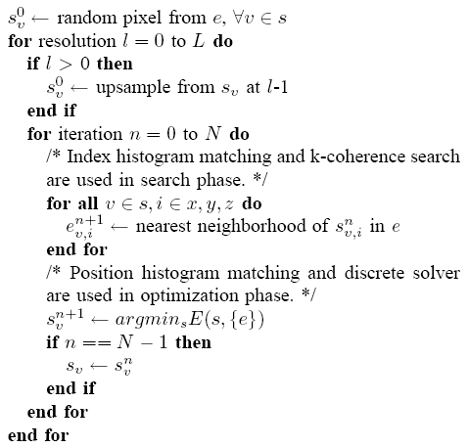
Our Algorithm
Optimization framework : Using an Expectation Maximization (EM)-like algorithm, progressively refines the entire texture
Two-phase iteration
Search phase
Optimization phase
Multi-resolution
Fixed smaller neighbor
Speed up

Slide 9
Search Phase
Fix every neighborhood sv,i, and update each ev,i by finding the best matching exemplar window for the corresponding sv,i
A standard nearest neighbor search in high-dimensional space
K-coherence search [Tong et al. 2002]
Apply PCA to reduce the dimensionality

Slide 10
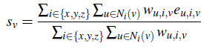
Optimization Phase
Fix all the nearest neighborhood ev,i, and update all the voxels sv, using the discrete solver [Han et al. 2006]
For each voxel, the pixel in { s(v) } = { eu,i,v | i € { x, y, z }, u € Ni(v) } that most reduces the energy function is chosen for the updated voxel
First calculates a prospective value sv using (2), and then select a texel eu,i,v from { s(v) } most similar to sv for the updated voxel
(2)

Slide 11
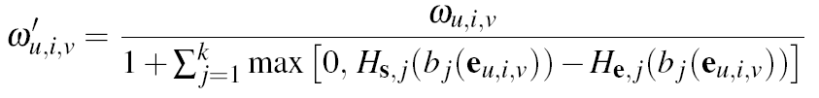
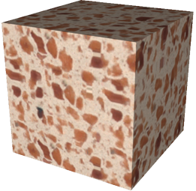
Color Histogram Matching and its Limitations
Energy function measures only the similarity of local neighborhoods, sometimes resulting in convergence to a wrong local minimum
Kopf et al. uses a re-weighting scheme, adjusting weights to ensure histograms of synthesized texture could match that of the exemplar
(2)

Slide 12
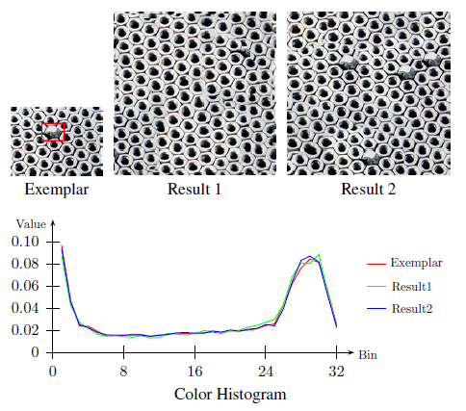
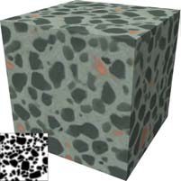
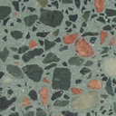
Color Histogram Matching and its Limitations
There are two conspicuous limitations existing in color histogram matching
Works only for color not for general structure information
It even fails to preserve color histogram sometimes

Slide 13
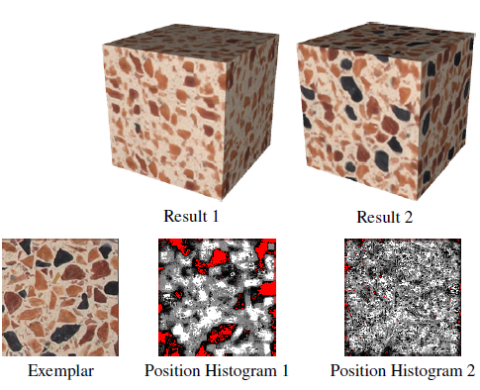
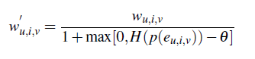
Position Histogram Matching
Definition
The histogram value is 0 in the red parts, and grows with the increase of brightness in the gray parts
In optimization phase
Using the re-weighting scheme

Slide 14
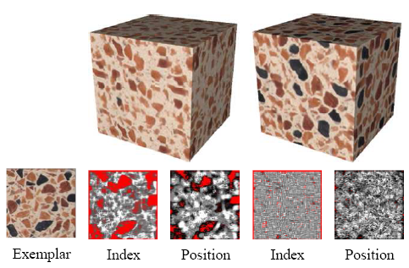
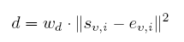
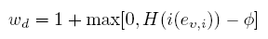
Index Histogram Matching
Definition
Similar to the position histogram matching
In search phase
Modifies the distance between two neighbors

Slide 15
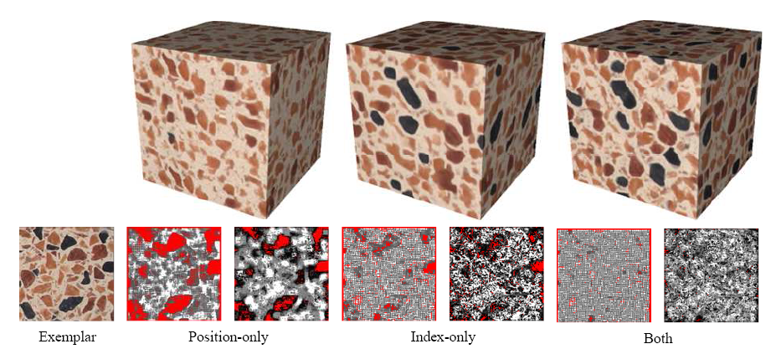
Benefits of position and index histogram matching

Slide 16
Results
Implemented using C++, taking 5 to 10 minutes for 128^3 solid textures on a 2.2 GHz CPU
3 levels synthesis pyramid
8*8 neighborhood for the lower two levels, and 6*6 for the highest one
Faster than Kopf et al. [2007] (10 to 90 minutes)
Produces better results than previous methods
Avoid color blurry
Not only color histogram but also the various texture structures are efficiently preserved

Slide 17
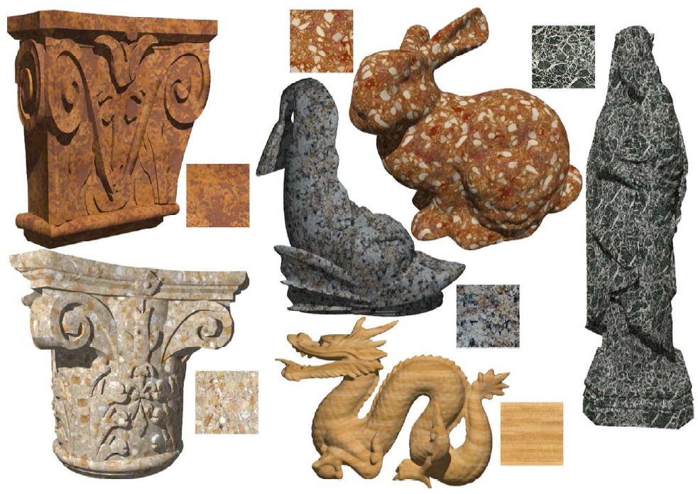
Surface Results

Slide 18
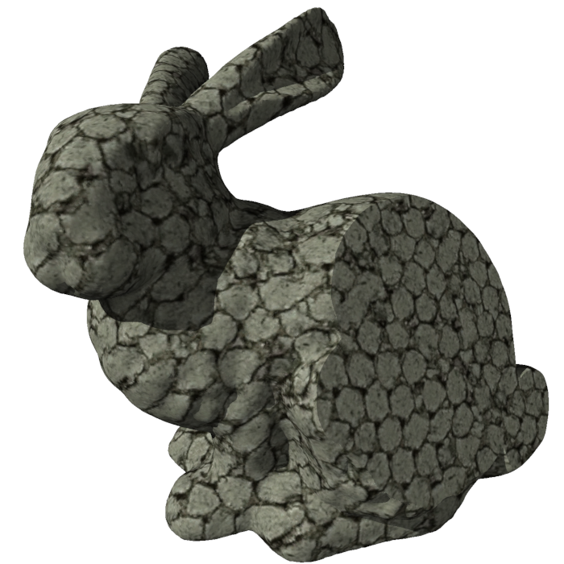


Interior Result
Exemplar
Feature map

Slide 19
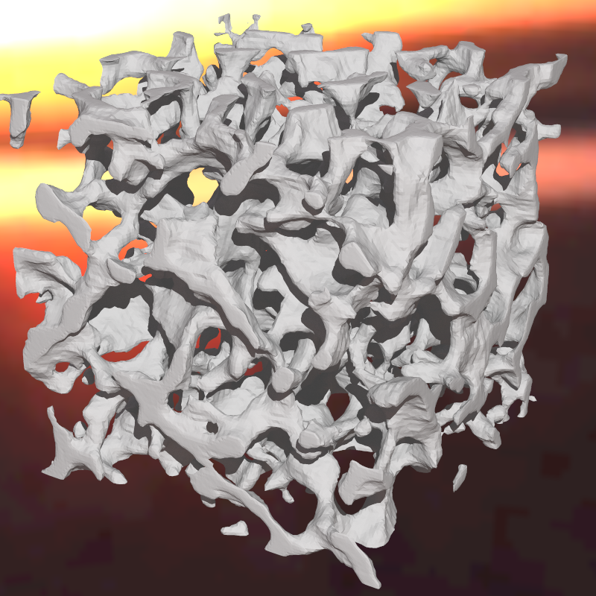
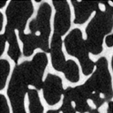
Complicated Structure Modeling
Ex.
Modeling result

Slide 20
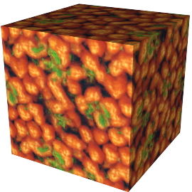
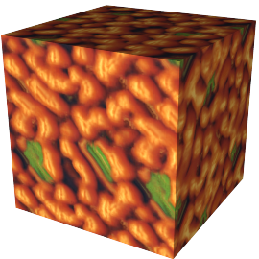
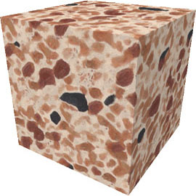
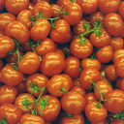

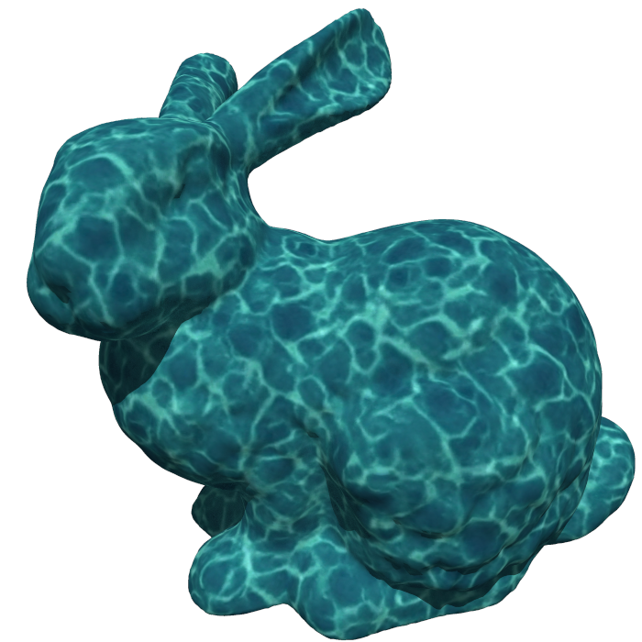
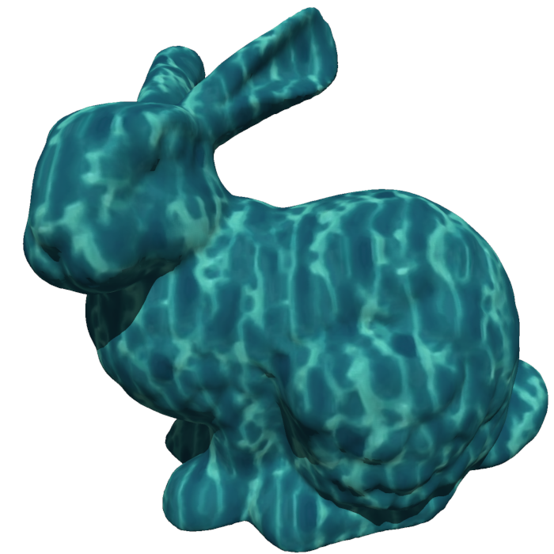
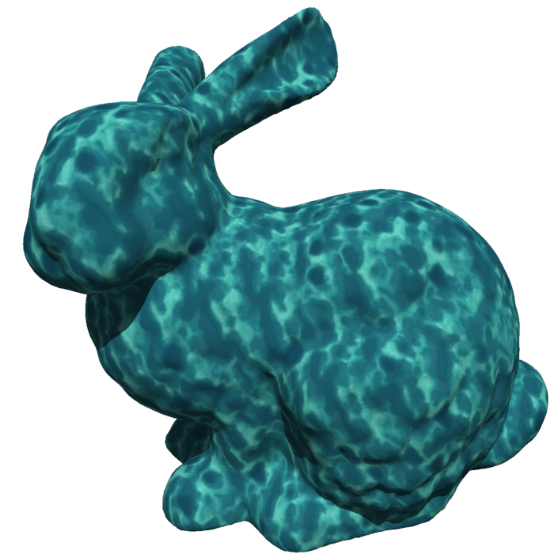

Comparisons
Ex.
Ours
Kopf et al.’s
Ex.
Ours
Kopf et al.’s
Ex.
Ours
Kopf et al.’s
Dong et al.’s

Slide 21
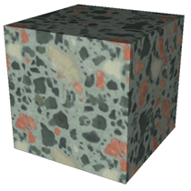
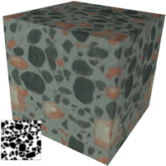
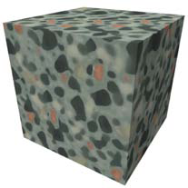
Comparisons: without feature map
Ours (Without feature map)
Dong et al.’s (With feature map)
Ex.
Kopf et al.’s(Without feature map)
Kopf et al.’s (With feature map)

Slide 22
Conclusions
A simple but effective algorithm for high quality solid texture synthesis
Enables most of the pixels in the exemplars to appear equiprobably in the result volume with the position and index histogram matching
Efficiently preserves not only color histogram but also the various texture structures in the results
Outperforms or at least is comparable to the previous solid texture synthesis approaches in terms of the synthesis quality.

Slide 23
Acknowledgements
The anonymous reviewers
Jun-Hai Yong, Fang Yang and Guidu Chen for help on writing
Thank You!

